Slide 1

Stakeholder Communication Hub
Date - 10/02/2025
Afnan Ahmed - RA2211042040009
Vyaas Sundar - RA2211042040010

Slide 2
Abstract: Stakeholder Communication Hub
Effective communication is critical for successful software engineering project management, yet many teams struggle with fragmented tools, delayed updates, and inefficient feedback loops. The Stakeholder Communication Hub aims to centralize project-related communication, ensuring seamless collaboration between developers, managers, and clients.
This platform integrates with existing project management tools like Slack, Jira, and Trello, providing real-time updates, automated progress reports, and role-based dashboards. By streamlining approvals, issue escalations, and notifications, the system enhances transparency, accountability, and decision-making.
With features such as automated status tracking, smart alerts, and a centralized communication log, the Stakeholder Communication Hub minimizes project delays, reduces miscommunication, and improves overall efficiency. The platform is designed to be scalable, secure, and adaptable to various team workflows, making it a valuable tool for modern software development teams.
Stakeholder Communication Hub

Slide 3
Objective
The primary objective of the Stakeholder Communication Hub is to enhance collaboration and transparency in software engineering project management by providing a centralized platform for communication. The system aims to:
Streamline stakeholder communication by integrating multiple project management tools into a single platform.
Automate status updates and reporting to reduce manual effort and keep stakeholders informed in real time.
Improve accountability and decision-making by maintaining clear records of discussions, approvals, and escalations.
Reduce project delays and bottlenecks by enabling faster feedback loops and issue tracking.
Enhance project visibility through role-based dashboards tailored for developers, managers, and clients.
Scope
The Stakeholder Communication Hub will serve as a centralized platform designed to streamline communication between developers, project managers, and clients. The project will focus on providing a simple yet effective system where stakeholders can receive automated project updates, track discussions, and manage approvals efficiently. Security measures will include basic authentication and role-based access control, ensuring that communication and project data remain secure. The system will be web-based, making it accessible across different devices without requiring complex installations.
To maintain a focused scope, the project will not include AI-powered decision-making or predictive analytics. Additionally, it will cater primarily to small and mid-sized teams rather than large enterprises. The goal is to create a lightweight but effective communication solution that reduces bottlenecks, improves transparency, and enhances collaboration in software engineering projects.
Stakeholder Communication Hub

Slide 4
Project Charter: Stakeholder Communication Hub
Project Title:
Stakeholder Communication Hub
Project Sponsor:
Afnan Ahmed
Project Manager:
Afnan Ahmed
Date:
10/02/2025
Stakeholder Communication Hub

Slide 5
1. Project Purpose & Justification
Effective communication is essential for successful software engineering projects, yet many teams struggle with fragmented tools, delayed updates, and inefficient feedback loops. The Stakeholder Communication Hub aims to solve these issues by providing a centralized platform that streamlines communication, automates project status updates, and improves collaboration between developers, project managers, and clients.
2. Project Objectives & Success Criteria
Objectives:
Develop a web-based communication platform for project stakeholders.
Automate project status updates and notifications.
Provide role-based access for developers, managers, and clients.
Integrate with email and one project management tool (e.g., Jira or Trello).
Ensure secure authentication and access control.
Success Criteria:
The platform successfully integrates with at least one project management tool.
Users can receive automated updates without manual effort.
Stakeholders can easily access relevant project information.
At least 80% of test users find the system improves communication efficiency.
Stakeholder Communication Hub

Slide 6
3. Scope Statement
The Stakeholder Communication Hub will be a web-based platform that centralizes communication, project updates, and approvals. It will allow managers, developers, and clients to track discussions, receive notifications, and collaborate effectively. The platform will have role-based access and a simple interface for ease of use.
To keep the project manageable, the initial release will include email integration and support for a single project management tool (e.g., Jira or Trello). Advanced features like AI-based insights and multi-tool integrations may be considered for future updates.
Out of Scope:
AI-powered decision-making and predictive analytics.
Integration with multiple project management tools in the initial phase.
Enterprise-level scalability beyond small to mid-sized teams.
4. Key Stakeholders
Project Sponsor: Oversees project funding and strategic alignment.
Project Manager: Leads project execution and ensures timely delivery.
Developers: Implement the platform and integrate required features.
Project Managers & Clients: End users who will rely on the platform for project communication.
QA Testers: Ensure platform functionality, usability, and security.
Stakeholder Communication Hub

Slide 7
5. Project Milestones
Phase 1: Requirements gathering and planning (2-4 weeks).
Phase 2: UI/UX design and prototyping (4 weeks).
Phase 3: Core development and integration (6-8 weeks).
Phase 4: Testing and feedback collection (4 weeks).
Phase 5: Deployment and initial rollout (2 weeks).
Phase 6: Post-launch monitoring and improvements (Ongoing).
6. Budget & Resources
Technology Stack: Web development framework (React, Node.js), database, hosting services.
Personnel: Developers, UI/UX designers, testers, project managers.
Other Costs: API usage fees, hosting, security implementation.
7. Risks & Mitigation Strategies
Integration challenges with third-party tools → Begin with one tool and expand gradually.
User adoption resistance → Provide simple onboarding guides and tutorials.
Security concerns → Implement encryption and role-based access control.
Scope creep → Clearly define MVP features and avoid unnecessary additions in early phases.
Stakeholder Communication Hub

Slide 8
8. Approval & Authorization
This project charter formally authorizes the development of the Stakeholder Communication Hub. Any changes to scope, budget, or timeline must be reviewed and approved by the project sponsor.
Approved by: Afnan Ahmed RA2211042040009
Vyaas Sundar
RA2211042040010
Stakeholder Communication Hub

Slide 9
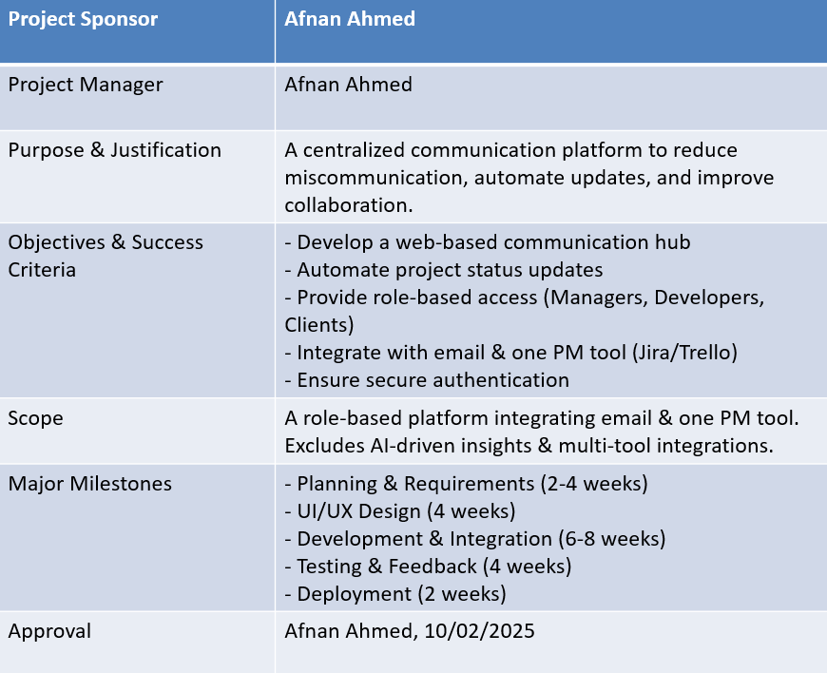
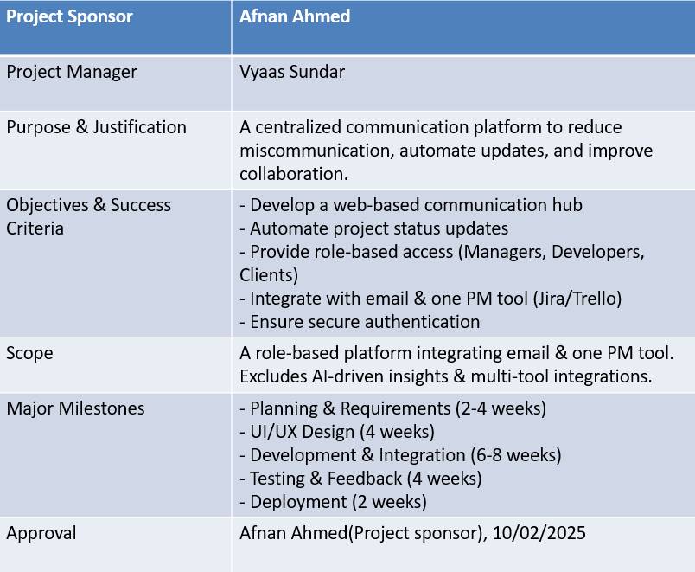
Project Charter: Stakeholder Communication Hub
Stakeholder Communication Hub

Slide 10
Thank You

